Slide 1
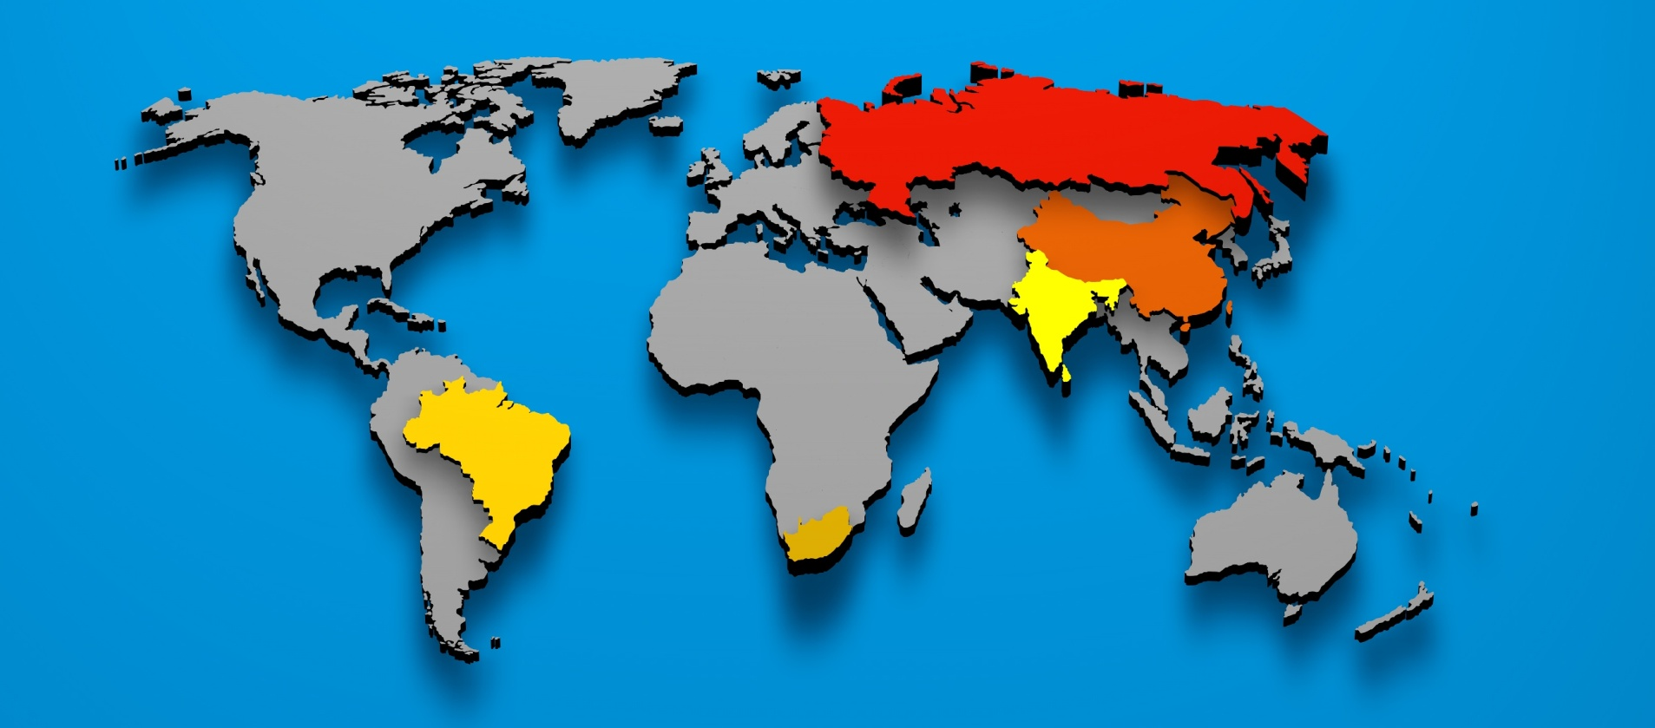
Where are the BRICS?

